Slide 1
IMO-WMU Workshop on Underwater Radiated Noise Reduction Policies & Strategies with a Focus on Developing Countries.
Critical Evaluation of the Implementation of IMO’s Guidelines for the Reduction of Underwater Radiated Noise: A Kenyan Perspective.
Swabra Abdulrahman.

Slide 2
Objectives
1. To explore and evaluate the extent of implementation of IMO’s URN Guidelines;
2. To examine best practice in the implementation of the Guidelines;
3. To determine recommendations for mitigating URN for developing nations, with Kenya as a case study.

Slide 3
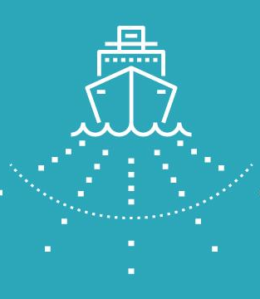
Research Questions
1. What are the challenges in mitigating underwater noise for different organisations?
2. What actions are considered significant in reducing URN?
3. What is considered as best practice in URN mitigation?
4. What are the the legal measures required to undertake implementation of the guidelines?
5. What are the recommendations to aid in implementation of the guidelines to diminish URN from vessels?

Slide 4
Recommendations
Q1: To determine the challenges of mitigating underwater noise from vessels.
Creating awareness and capacity building on underwater noise:
Experience Building Phase (EPB)
Community Based Social Marketing (CBSM)
Funding and Study opportunities
Information sharing through GISIS
Technology transfer through best practice:
Uptake of new technologies
Pilot Projects

Slide 5
Recommendations Q2&3: Actions required and what is considered as best practice in URN mitigation.
Best Practice
Technological Measures
Operational Measures
Precautionary Measures
Incentives
Transdisciplinary approach to mitigation measures:
Share knowledge ideas and challenges on URN mitigation measures
Linkages to other climate change measures such as Energy Efficiency measures in decarbonisation
Polluter Pays Principle

Slide 6
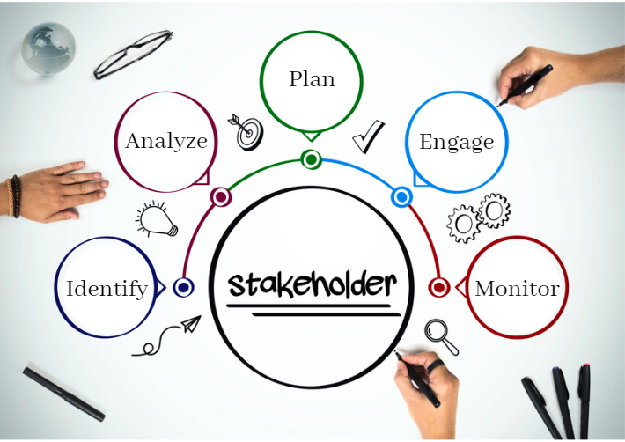
Recommendations Q4: The extent of legal measures required to undertake implementation.
Legal measures
Binding and enforceable regulations
Partial implementation of key provisions
Stakeholder management approach
3 Cs: Collaboration, Coordination and Cooperation
Top-down approach
Prioritizing stakeholders
Regional Approach

Slide 7
Thank you for your attention!
Swabra Abdulrahman MSc Student Maritime Law and Policy

